Slide 1
Head Tracking
4002.790.01 – Emerging Themes
Joe Pietruch

Slide 2


What is Head Tracking?
Viewer's Position relative to Display
Display Size and Viewing Angle
Viewpoint Dependent 3D Display
v

Slide 3
Emerging ... How?
Sensing Systems
Processing Power/Speed
Smart People
Demand for Engaging Experiences

Slide 4
Real-World Examples
Johnny Chung Lee – http://www.youtube.com/watch?v=Jd3-eiid-Uw
TrackIR – http://www.youtube.com/watch?v=IbL3zLWFqI8

Slide 5
Is it Practical?
Compared to the alternatives:
  Polarized Projection
  Shutter Glasses
  Pepper's Ghost
  Spinning Mirrors
Cheap and Easy

Slide 6
Benefits
Works with existing Display
Convincing Interaction
One step closer to the Holodeck!
Gets Players off the Sofa

Slide 7
Drawbacks
Gets Players off the Sofa
Single Player Simultaneously
Screen Edges Break Illusion
Requires Calibration
Requires Headgear

Slide 8
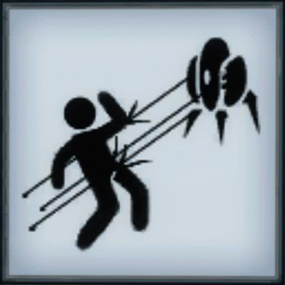
My Prototype
Get it up and running.
Get a Virtual Turret tracking Player
“Hiding” Mechanic: Dive behind the sofa?
Game: Shoot or be shot!

Slide 9
Head Tracking
4002.790.01 – Emerging Themes
Joe Pietruch

